Slide 1
FARMER PROJECT
Arundhati Bhattacharya

Slide 2


Slide 3
Landing page
Login
Home
Abou Us
Gallery
Contact
Feed Back
Admin
Farmer
Shop Dealers
Advisor

Slide 4
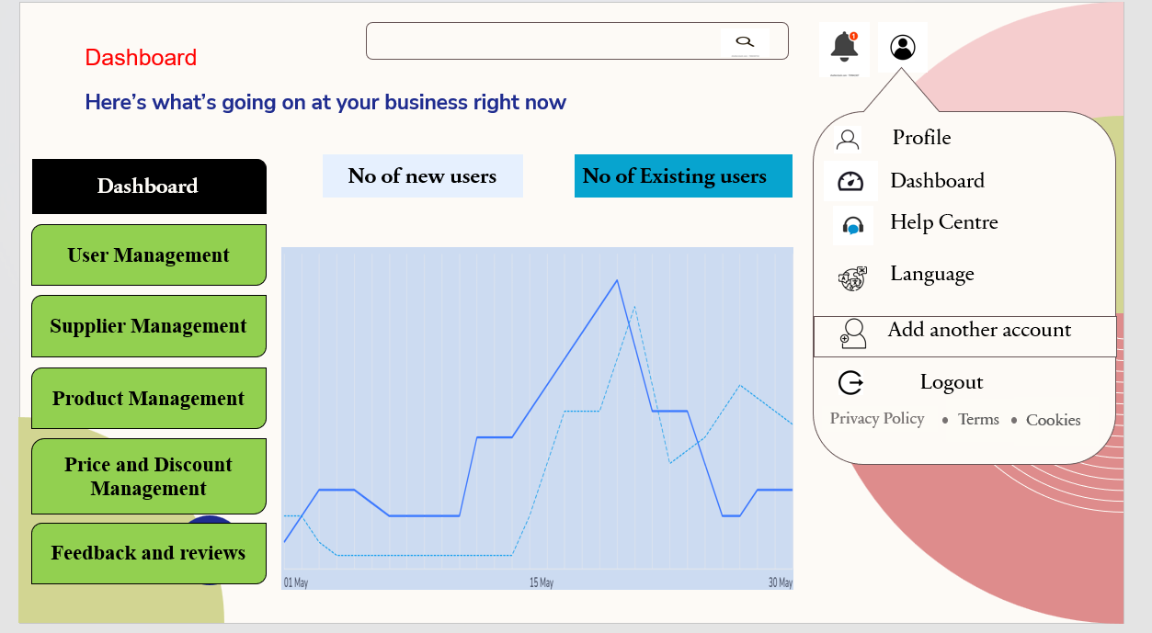

Slide 5
User Management
Dashboard
Sign Up
Login
User Management
First Name
Last Name
login
Supplier Management
Email
Password
Password
Product Management
Confirm Password
LOG IN
Price and Discount Management
I accept the Terms and conditions
Feedback and reviews
Sign Up
Forgot Password?

Slide 6


Supplier management
Supplier details:
Add New+
Dashboard
User Management
Contact No | Product Name | Shop name | Location | Actions
Supplier Management
Product Management
Price and Discount Management
Feedback and reviews

Slide 7
Product Management
Add New+
Dashboard
User Management
Seeds | Fertilizer | Pesticides | Machinery | Options
Supplier Management
Product Management
Price and Discount Management
Feedback and reviews

Slide 8
Price and Discount Management
Dashboard
Price and Discount Management
Edit
User Management
SEP 2023
NOV 2023
JAN 2024
MAR 2024
MAY 2024
Supplier Management
NOV 2023
JAN 2023
MAR 2024
MAY 2024
AUG 2024
Product Management
Rice 10%
Wheat 9%
Maize 11%
Cotton 10%
Coffee 12%
Price and Discount Management
Feedback and reviews

Slide 9
Feedback and reviews
Dashboard
Rating
User Management
.
Supplier Management
Product Management
Price and Discount Management
Feedback and reviews

